Slide 1
Getis-Ord General G
Also called high/low clustering analysis: another tool for spatial statistic.
If p-value small → statistically significant → the null hypothesis can be rejected
The higher /lower z score→ stronger/weaker the intensity of the clustering.
In Pysal: only weight distance is applicable for Getis-Ord.
Local Getis-Ord or Local Moran I will verify the local clustering or hot/cool spots analysis

Slide 2
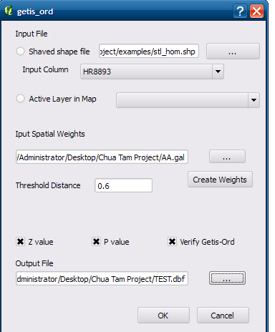
Output Sample

